Slide 1
Welcome
Home
Personalization
Browse Content by Subfield
Search and Filter Results
Full Text View
Citing, Printing, and Sharing
Welcome to a guided tour of the Oxford Research Encyclopedias (OREs). Please click the forward arrows to advance to the next section or click on a topic in the left-hand table of contents to skip ahead. Revisit the previous section by clicking the back arrow.
Saved Content
More Information
Next

Slide 2
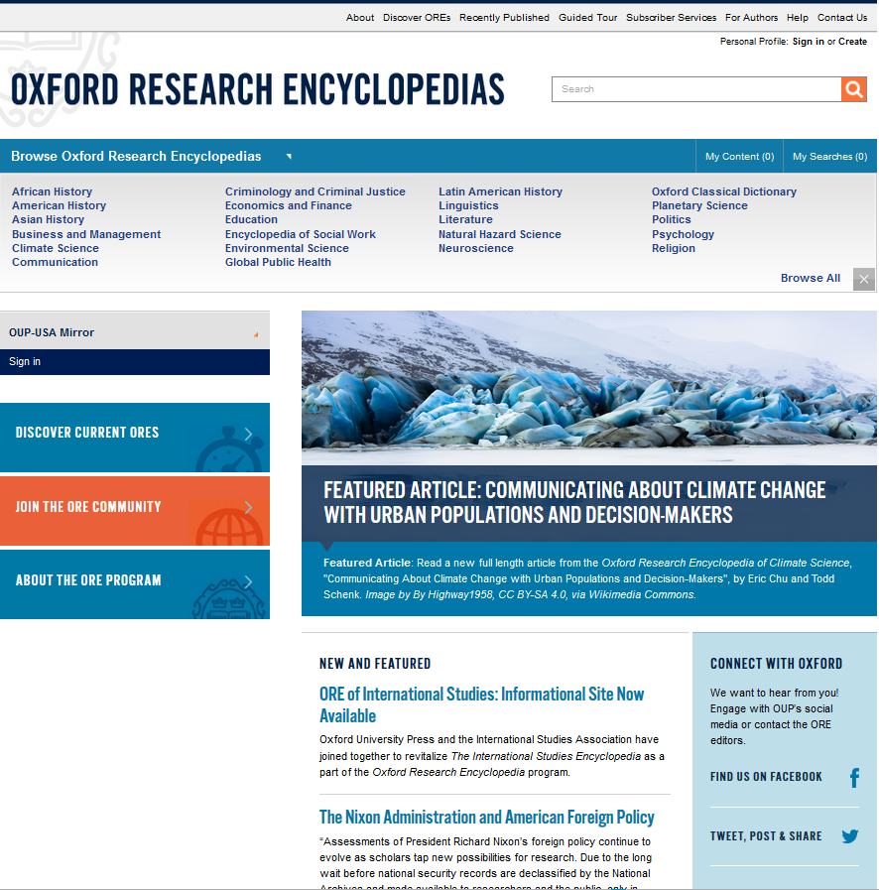
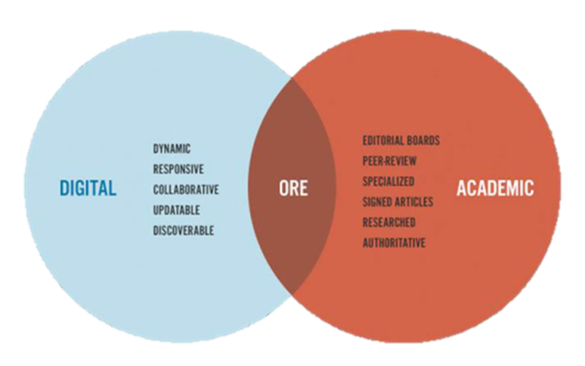
OXFORD RESEARCH ENCYCLOPEDIAS
Welcome
The Oxford Research Encyclopedias (OREs) offer long-form overview articles written, peer-reviewed, and edited by leading scholars. The OREs cover both foundational and cutting-edge topics in order to develop, over time, an anchoring knowledge base for major areas of research across the humanities, social sciences, and sciences.
Today, serious, quality research is challenged by the confounding proliferation of information and misinformation readily accessible online. The OREs draw on expert authors who are able to push beyond the basic facts to provide a researcher with a reliable understanding of an unfamiliar topic.
Substantive, peer-reviewed, and regularly updated, the Oxford Research Encyclopedias combine the speed and flexibility of digital with the rigorous standards of academic publishing. Multi-media features embedded in the articles, along with cross-referenced links to related content, will further expand the utility and scope of the ORE.
Home
Personalization
Browse Content by Subfield
Search and Filter Results
Full Text View
Citing, Printing, and Sharing
Saved Content
More Information

Slide 3
OXFORD RESEARCH ENCYCLOPEDIAS
Welcome
Browse content by subject
Run a full-text search across all content
Home
Personalization
Browse Content by Subfield
Connect with OUP via social media, or contact the ORE team
Search and Filter Results
New and Featured content updates
Full Text View
Citing, Printing, and Sharing
Saved Content
More Information
Learn more about the ORE project and community

Slide 4
OXFORD RESEARCH ENCYCLOPEDIAS
Welcome
Home
Sign in to your user profile to personalize your research experience
Personalization
Browse Content by Subfield
Review saved and recently viewed content and searches
Search and Filter Results
Full Text View
Citing, Printing, and Sharing
Saved Content
More Information

Slide 5
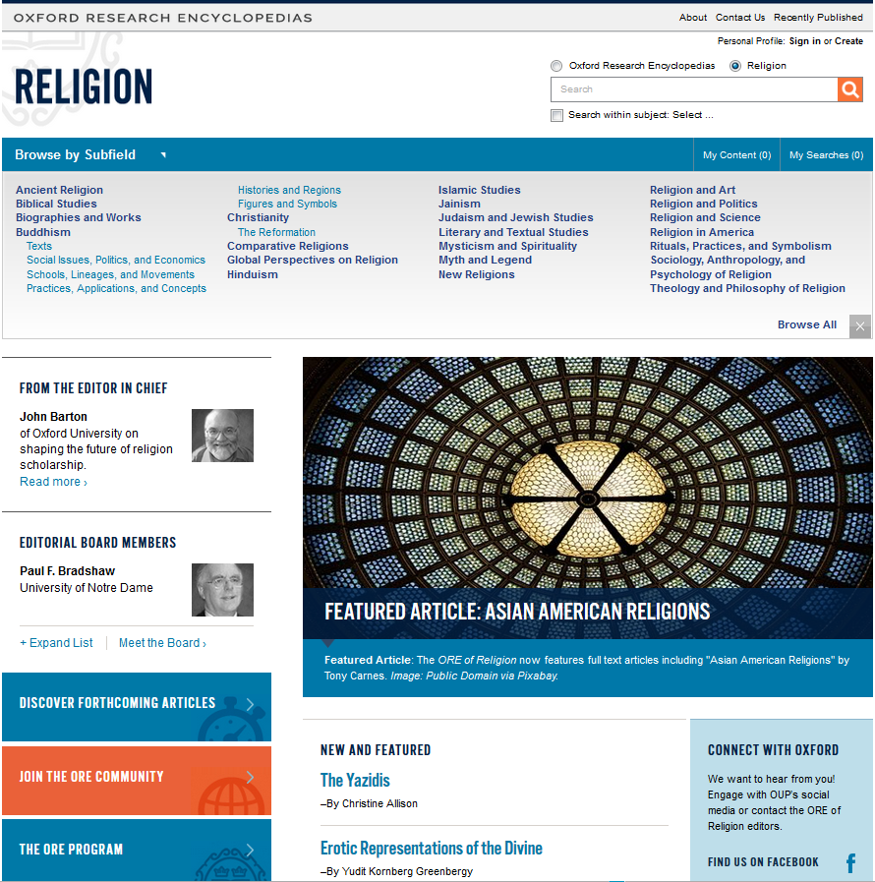
OXFORD RESEARCH ENCYCLOPEDIAS
Welcome
Home
Personalization
Browse Content by Subfield
Browse by subfield from each ORE subject’s homepage (religion.oxfordre.com)
Search and Filter Results
Full Text View
Search within each subject, each subfield, or across all ORE content
Citing, Printing, and Sharing
Saved Content
More Information
Meet the subject’s editorial board

Slide 6
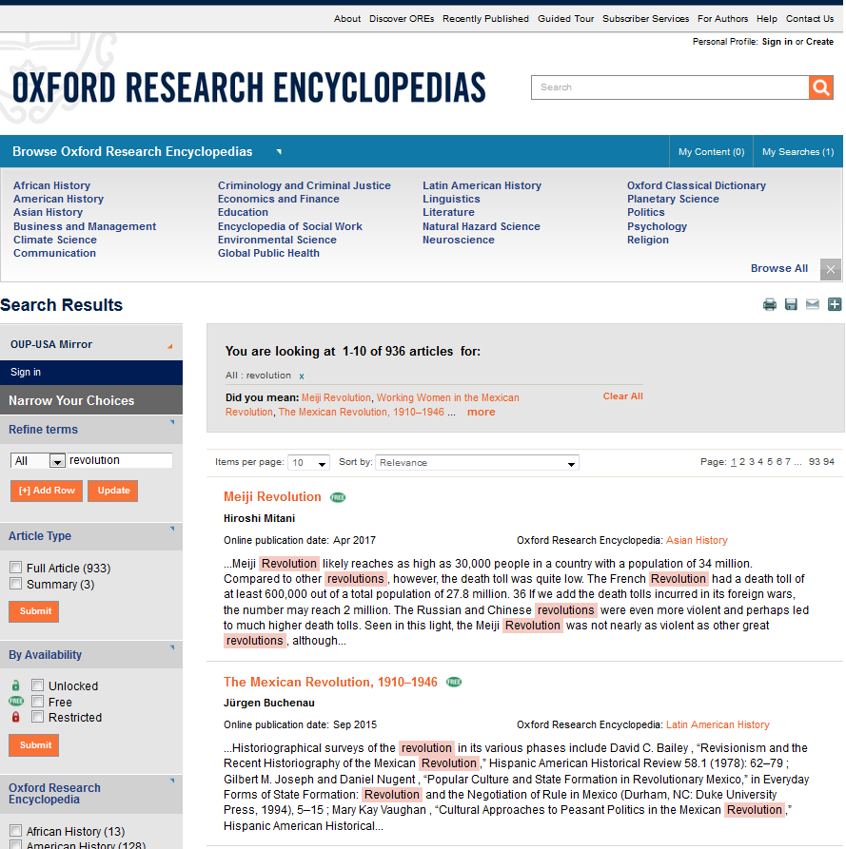
OXFORD RESEARCH ENCYCLOPEDIAS
Welcome
Home
Filter by Article Type, Availability, Subject, or add additional search terms
Print, save, email, or share this list of search results
Sort results by relevance, title, author/editor name, or publication date
Personalization
Browse Content by Subfield
Search and Filter Results
Full Text View
Citing, Printing, and Sharing
Saved Content
Search term will appear highlighted within the list of results
More Information

Slide 7
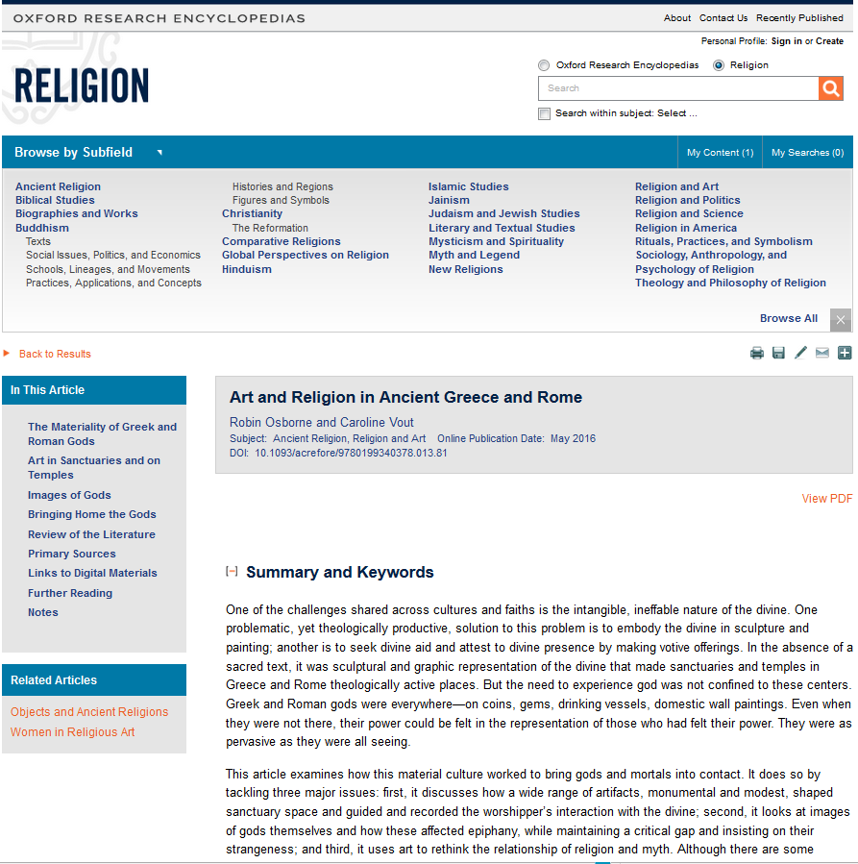
OXFORD RESEARCH ENCYCLOPEDIAS
Welcome
Home
Article heading contains article title, author(s), subfields, publication date, and DOI
Jump ahead by exploring this article’s Table of Contents
Personalization
Browse Content by Subfield
Search and Filter Results
Full Text View (1/2)
Citing, Printing, and Sharing
Saved Content
Explore related articles
More Information

Slide 8
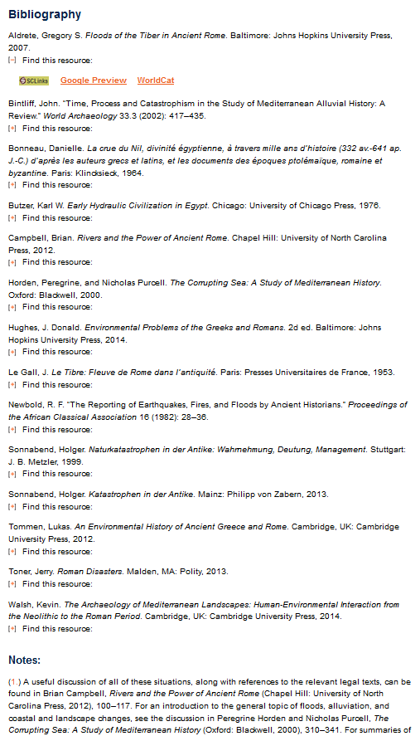
OXFORD RESEARCH ENCYCLOPEDIAS
Welcome
Home
Citations in Bibliography are OpenURL compliant. Expand by clicking Find This Resource.
Personalization
Browse Content by Subfield
Search and Filter Results
Full Text View (2/2)
Notes will link directly to their location in the article text, and vice versa.
Citing, Printing, and Sharing
Saved Content
More Information

Slide 9
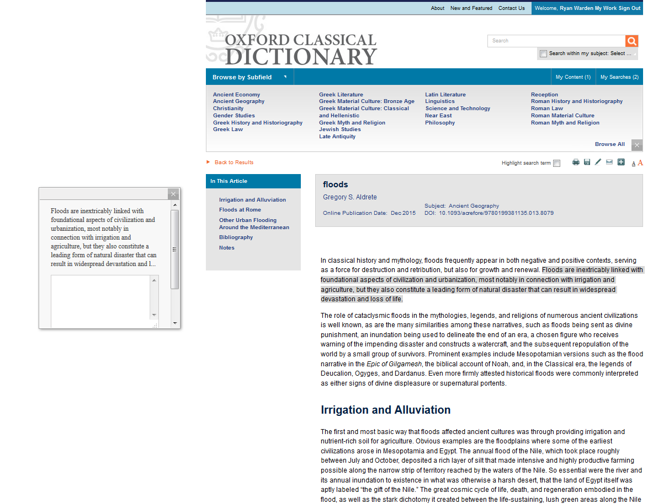
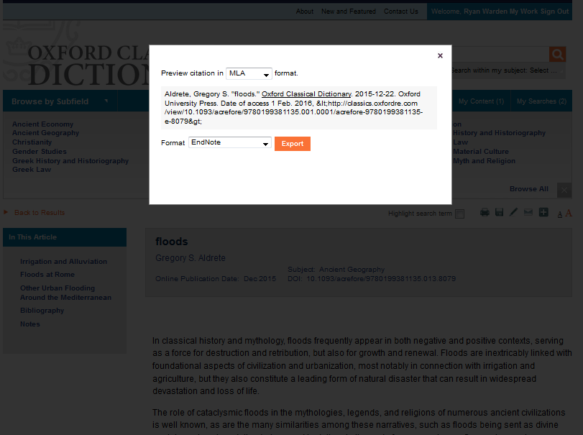
OXFORD RESEARCH ENCYCLOPEDIAS
Welcome
Print, save, cite, email, or share an article
Home
Annotate articles by highlighting text and choosing the Annotate pop-up option. Annotations will be saved to your personal profile for future use.
Personalization
Browse Content by Subfield
Search and Filter Results
Full Text View
Citing, Printing, and Sharing
Select cite to generate a full citation of the article in your preferred style and using your preferred citation manager.
Saved Content
More Information

Slide 10
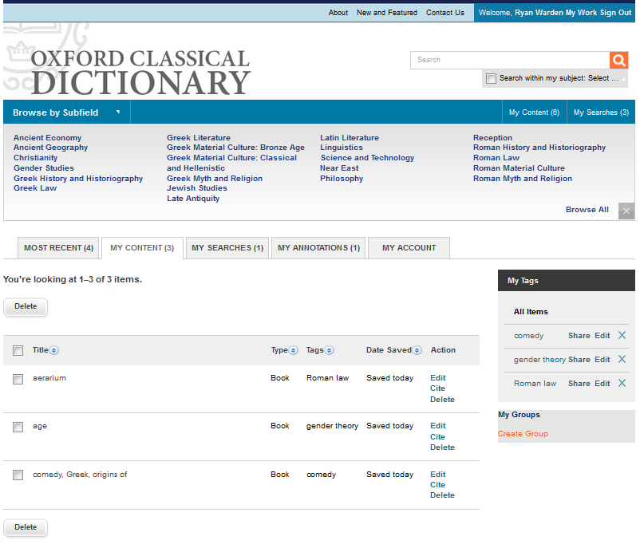
OXFORD RESEARCH ENCYCLOPEDIAS
Welcome
Review and Edit saved content, annotations, and searches. Update My Account with new email and password.
Home
View saved content in personal profile under My Work.
Personalization
Browse Content by Subfield
Search and Filter Results
Full Text View
Citing, Printing, and Sharing
Saved Content
Organize saved content with personalized tags
More Information
Edit, cite, or delete saved items

Slide 11
OXFORD RESEARCH ENCYCLOPEDIAS
Welcome
General Information
Still have questions? Please visit our Frequently Asked Questions, About page, or Help page, which may provide the answer.
Schedule a personalized training session:
North and South America: oxfordtrainingamericas@oup.com
Outside North and South America: onlinetraining@oup.com
Technical Support
North and South America:
Tel: 1.800.334.4249 ext 6484
Fax: 1.212.726.6467
Email: oxfordonline@oup.com
Outside of North and South America:
Tel: +44 (0)1865 353705
Fax: +44 (0)1865 353308
Email: onlinesubscriptions@oup.com
Home
Personalization
Browse Content by Subfield
Search and Filter Results
Full Text View
Citing, Printing, and Sharing
Saved Content
More Information
Back

